Slide 1
Context-Free Grammars
G = (V, T, S, P)
Productions are of the form:
A → x
A ∈ V and x ∈ (V ∪ T)*

Slide 2
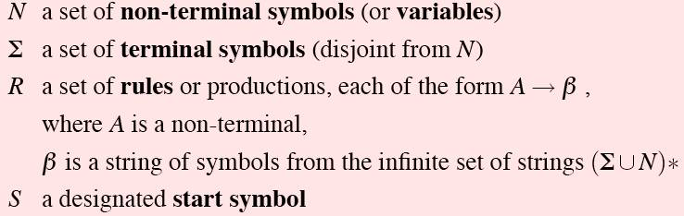
Definition
More formally, a CFG consists of

Slide 3
Example 1
G = ({S}, {a, b}, S, P)
P = { S → aSa
S → bSb
S → λ
}
S ⇒ aSa ⇒ aaSaa ⇒ aabSbaa ⇒ aabbaa

Slide 4
Example 2
G = ({S, A, B}, {a, b}, S, P)
P = { S → abB
A → aaBb
B → bbAa
A → λ
}
S ⇒ abB ⇒ abbbAa ⇒ abbbaaBba ⇒ abbbaabbAaba ⇒ abbbaabbaba

Slide 5
Example 3
P = { S → AS₁ | S₁B
S₁ → aS₁b | λ
A → aA | a
B → bB | b
}
Derive 2-3 strings using the grammar

Slide 6
Derivations
G = ({S, A, B}, {a, b}, S, {S → AB, A → aaA, A → λ, B → Bb, B → λ}) 1 2 3 4 5
S ⇒ AB ⇒ aaAB ⇒ aaB ⇒ aaBb ⇒ aab
S ⇒ AB ⇒ ABb ⇒ aaABb ⇒ aaAb ⇒ aab
1
2
3
4
5
1
4
2
5
3

Slide 7
Derivations
Leftmost: in each step the leftmost variable in the sentential form is replaced.
Rightmost: in each step the rightmost variable in the sentential form is replaced.

Slide 8
Example
G = ({S, A, B}, {a, b}, S, {S → AB, A → aaA, A → λ, B → Bb, B → λ}) 1 2 3 4 5
S ⇒ AB ⇒ aaAB ⇒ aaB ⇒ aaBb ⇒ aab Left
S ⇒ AB ⇒ ABb ⇒ aaABb ⇒ aaAb ⇒ aab Right
1
2
3
4
5
1
4
2
5
3

Slide 9
Derivation Trees
A → abABc
A
a
b
A
B
c
ordered tree

Slide 10
Derivation Trees
Let G = (V, T, S, P) be a context-free grammar.
An ordered tree is a derivation tree iff:
The root is labeled S.
Every leaf has a label from T ∪ {λ}.
Every interior vertex has a label from V.
A vertex has label A∈V and its children are labeled a₁, a₂, ..., a_{n} iff
P contains the production A → a₁ a₂ ... a_{n}.
A leaf labeled λ has no siblings.

Slide 11
Derivation Trees
Let G = (V, T, S, P) be a context-free grammar.
An ordered tree is a partial derivation tree iff:
The root is labeled S.
Every leaf has a label from T ∪ {λ}.
Every leaf has a label from V ∪ T ∪ {λ}.
Every interior vertex has a label from V.
A vertex has label A∈V and its children are labeled a₁, a₂, ..., a_{n} iff
P contains the production A → a₁ a₂ ... a_{n}.
A leaf labeled λ has no siblings.

Slide 12
Derivation Trees
The string of symbols obtained by reading the leaves of a tree from left to
right (omitting any λ's encountered) is called the yield of the tree.

Slide 13
Derivation Trees
S
S → aAB
A → bBb
B → A | λ
yield: abbbb
a
A
B
b
b
B
A
λ
b
b
B
λ

Slide 14
Derivation Trees
S
S → aAB
A → bBb
B → A | λ
a
A
B
b
b
B
A
λ
b
b
partial derivation tree
B
λ

Slide 15
Sentential Forms & Derivation Trees
Let G = (V, T, S, P) be a context-free grammar.
w∈L(G) iff there exists a derivation tree of G whose yield is w.
If t_{G} is a partial derivation tree of G whose root label is S,
then the yield of t_{G} is a sentential form of G.

Slide 16
Parsing
Parsing: finding a sequence of productions by which
w∈L(G) is derived.

Slide 17
Parsing
S → SS | aSb | bSa | λ w = aabb

Slide 18
Chomsky Normal Form
A context-free grammar G = (V, T, S, P) is in Chomsky normal form iff all productions are of the form:
A → BC
or
A → a
where A, B, C ∈ V and a ∈ T.

Slide 19
Example
Step 1
S→ABA’
A’→a
A→A’A’B’
B’→b
B→AC
C→c
Step 2
S→AD
D→BA’
A’→a
A→A’E’
E→A’B’
B’→b
B→AC
C→c
Ex:
S → ABa
A → aab
B → Ac

Slide 20
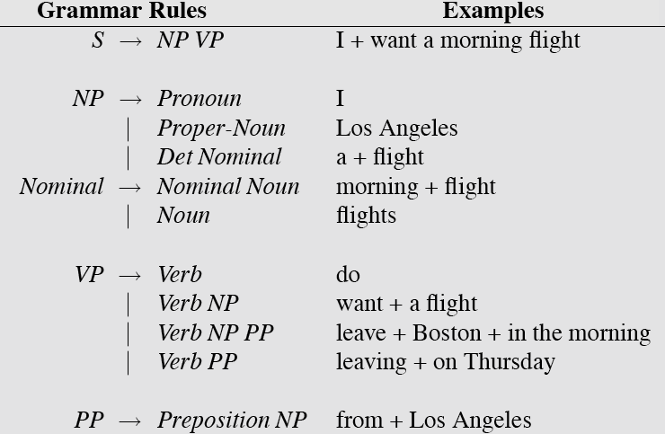
CFG example for English sentence

Slide 21
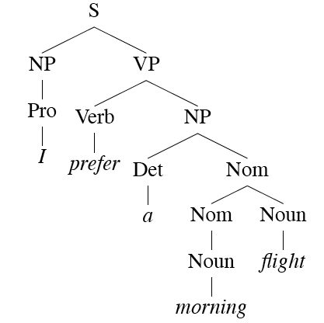
Derivations/ Parsing
Derive the string
“ I prefer a morning flight.”

Slide 22
CKY Parsing
First we’ll limit our grammar to epsilon-free, binary rules (more later) ie. CNF
Consider the rule A → BC
If there is an A somewhere in the input then there must be a B followed by a C in the input.
If the A spans from i to j in the input then there must be some k st. i<k<j
Ie. The B splits from the C someplace.

Slide 23
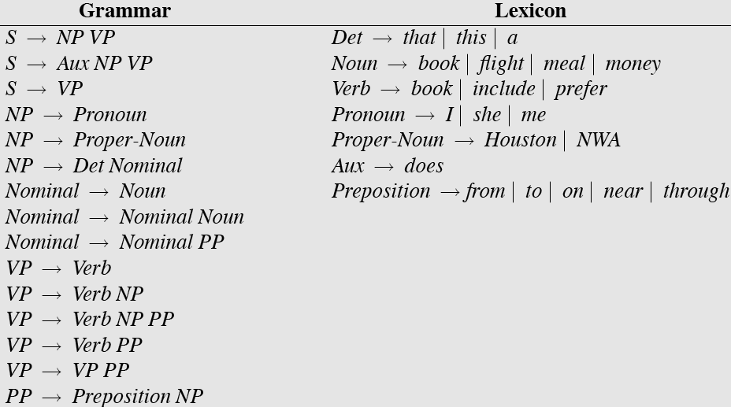
Sample L₁ Grammar

Slide 24
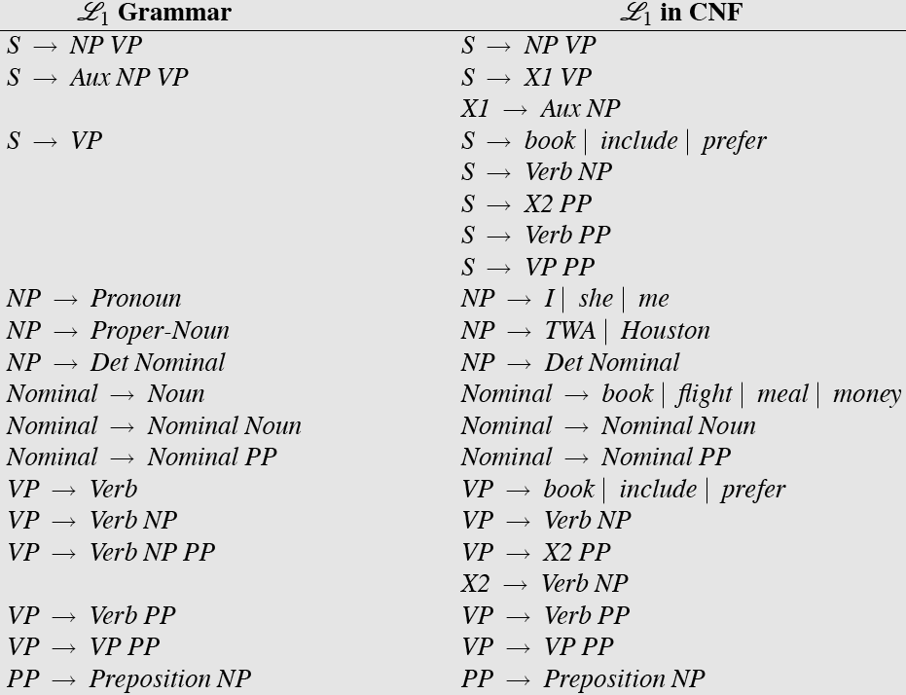
CNF Conversion

Slide 25
CKY
So let’s build a table so that an A spanning from i to j in the input is placed in cell [i,j] in the table.
So a non-terminal spanning an entire string will sit in cell [0, n]
Hopefully an S
If we build the table bottom-up, we’ll know that the parts of the A must go from i to k and from k to j, for some k.

Slide 26
CKY
Meaning that for a rule like A → B C we should look for a B in [i,k] and a C in [k,j].
In other words, if we think there might be an A spanning i,j in the input… AND
A → B C is a rule in the grammar THEN
There must be a B in [i,k] and a C in [k,j] for some i<k<j

Slide 27
CKY
So to fill the table loop over the cell[i,j] values in some systematic way
What constraint should we put on that systematic search?
For each cell, loop over the appropriate k values to search for things to add.

Slide 28
Final CFG in CNF form

Slide 29
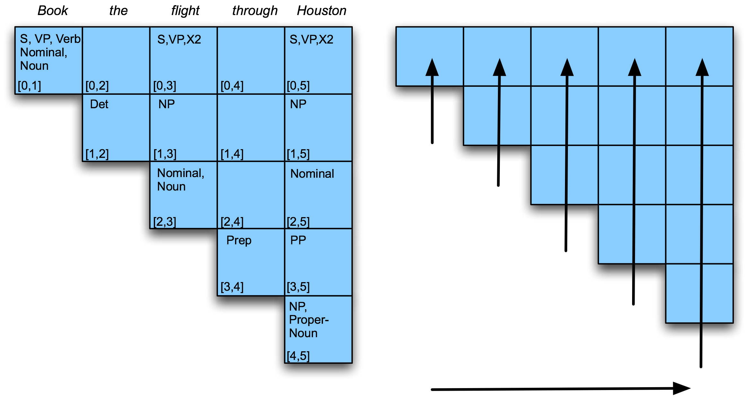
Example

Slide 30
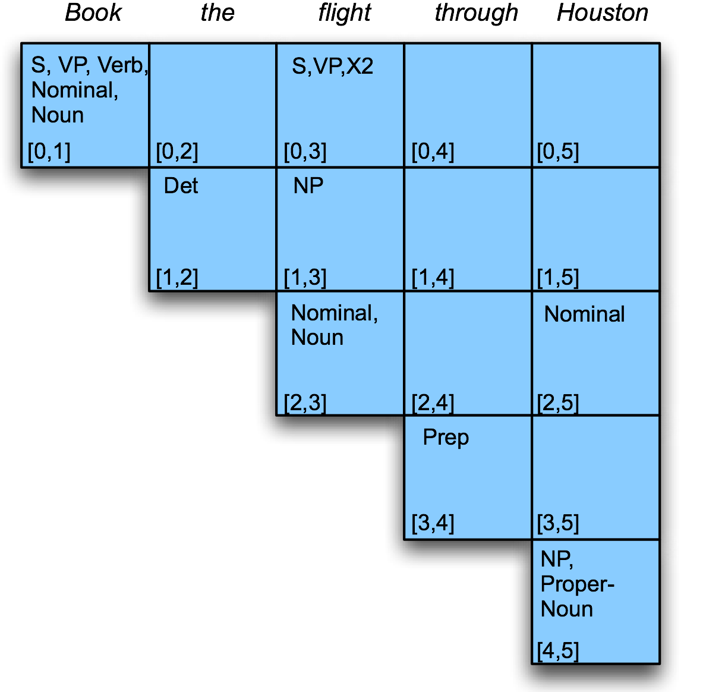
Example
Filling column 5
Notes:
For (02) ------(01)(12) -----------{s,vp,verb,noun, norminal} {Det}------- no prod so null
Simiralry fill (13) ; (24); (35)
Then for (03) --------- (01)(13) or (02)(23) explore tehm and see.

Slide 31
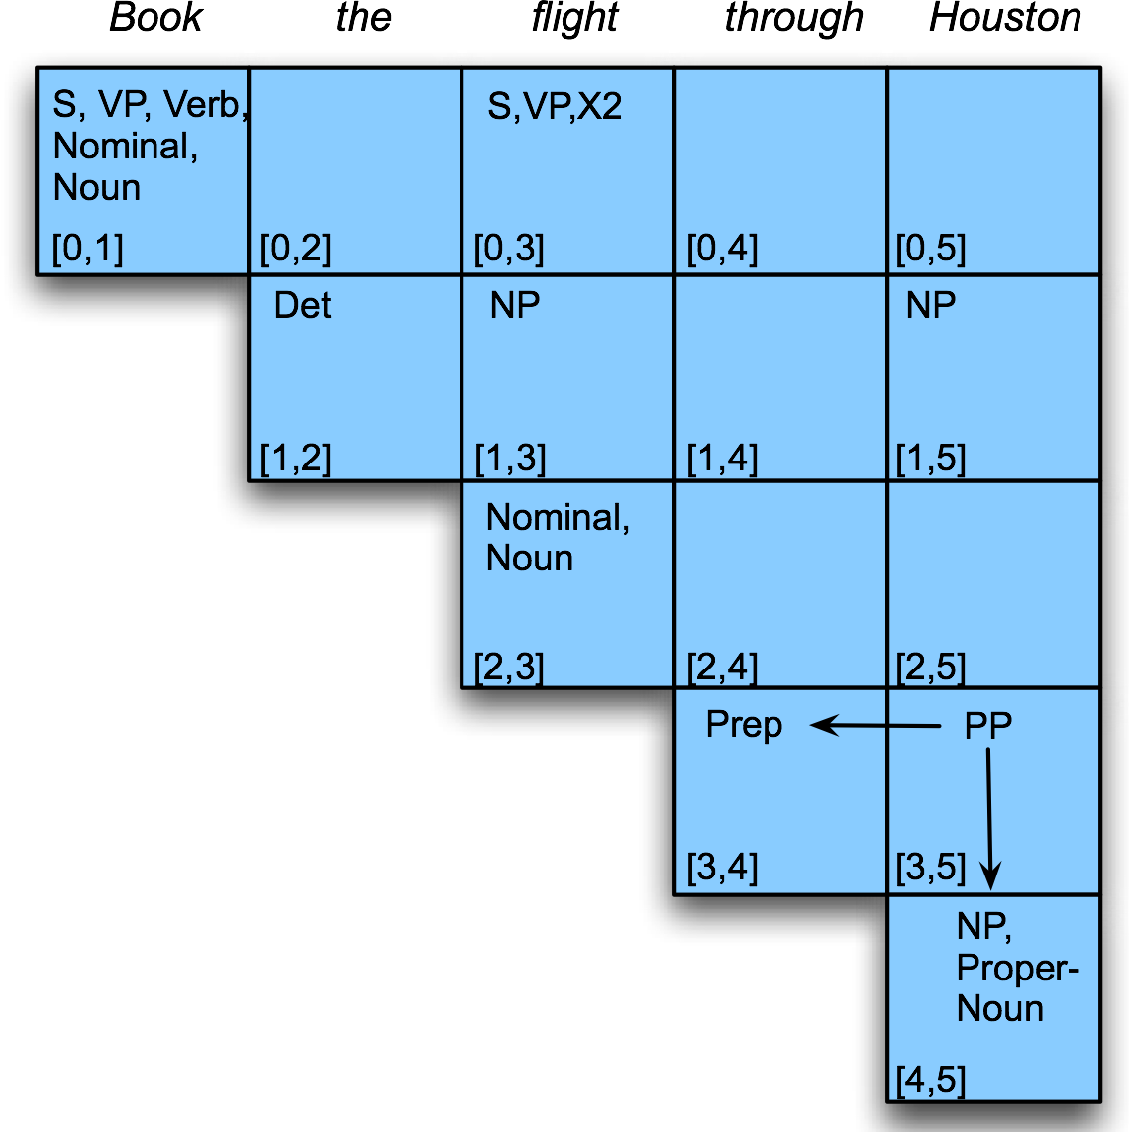
Example

Slide 32
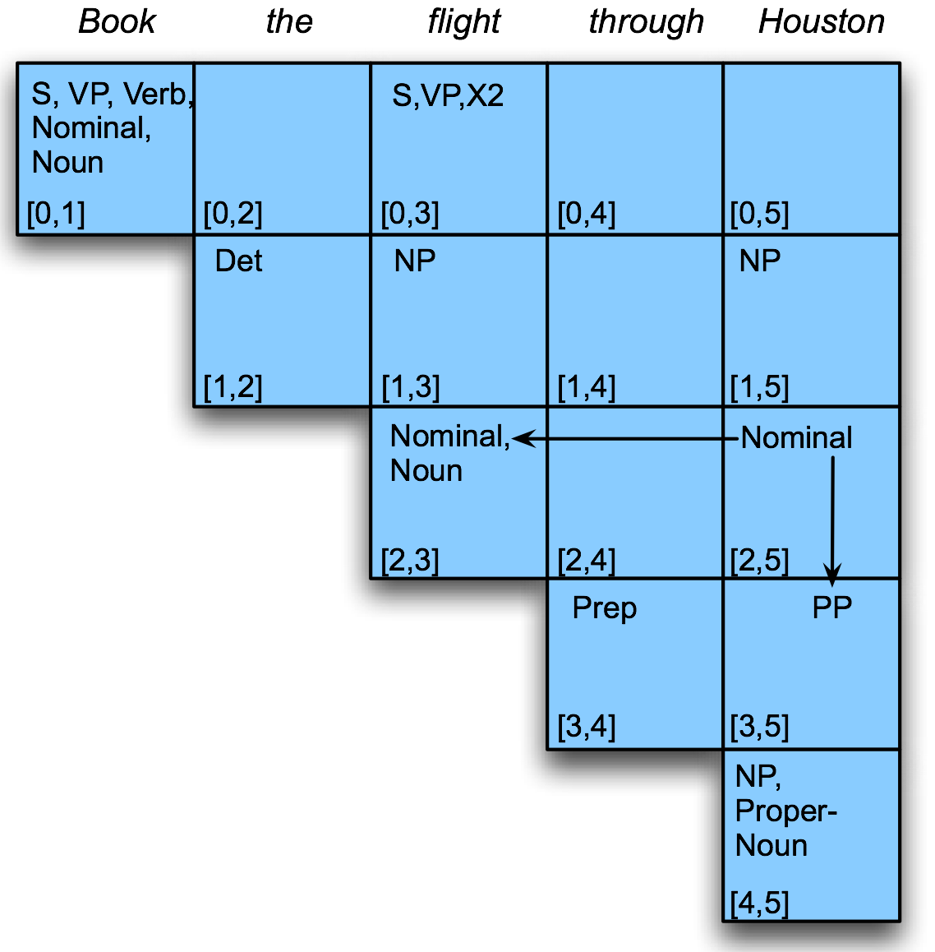
Example

Slide 33
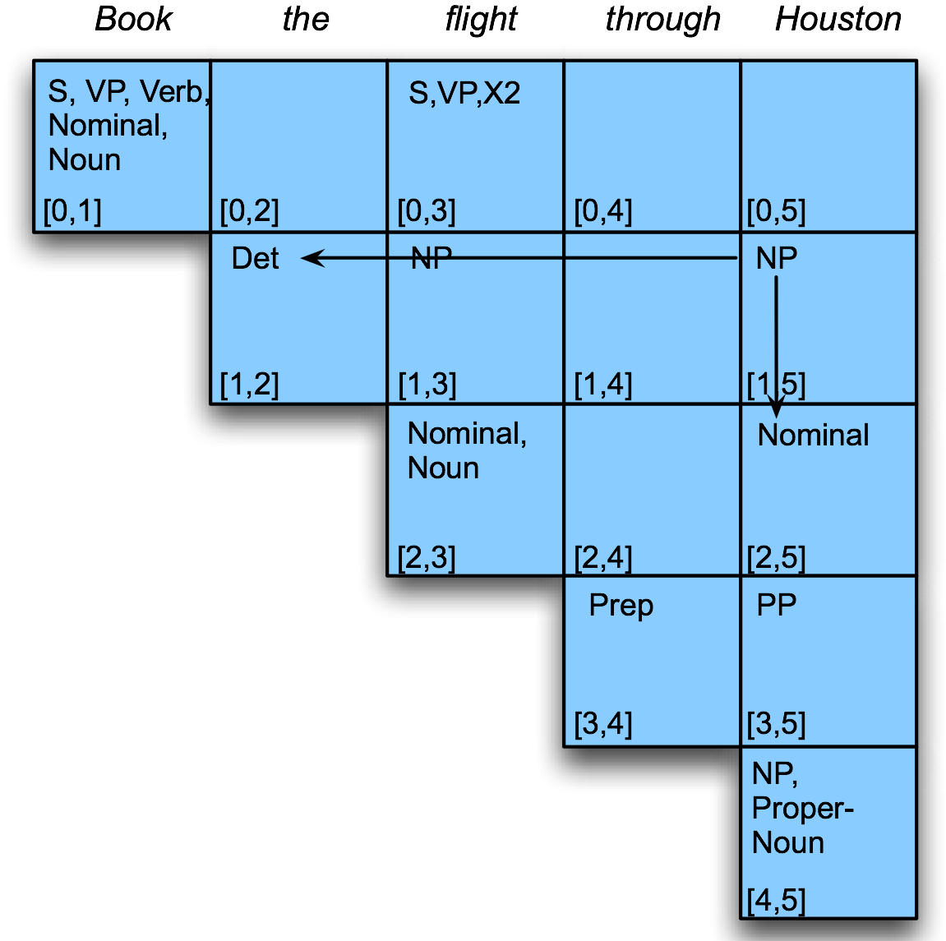
Example

Slide 34
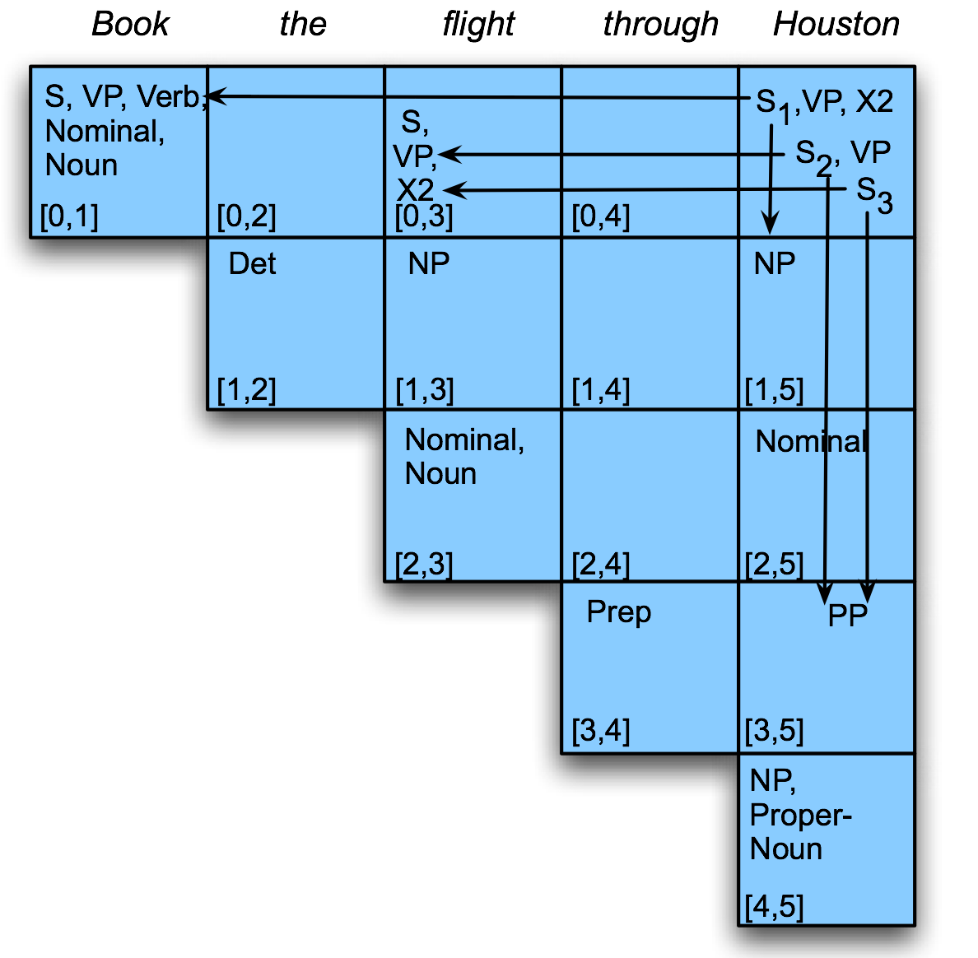
Example
Notes:
All possible parse tree are explored using CYK….. all the parses for a given input may incur considerable cost. Can be exponential cost

